Slide 1


WELCOME
CELL PHONE & BUSINESS SAFETY

Slide 2
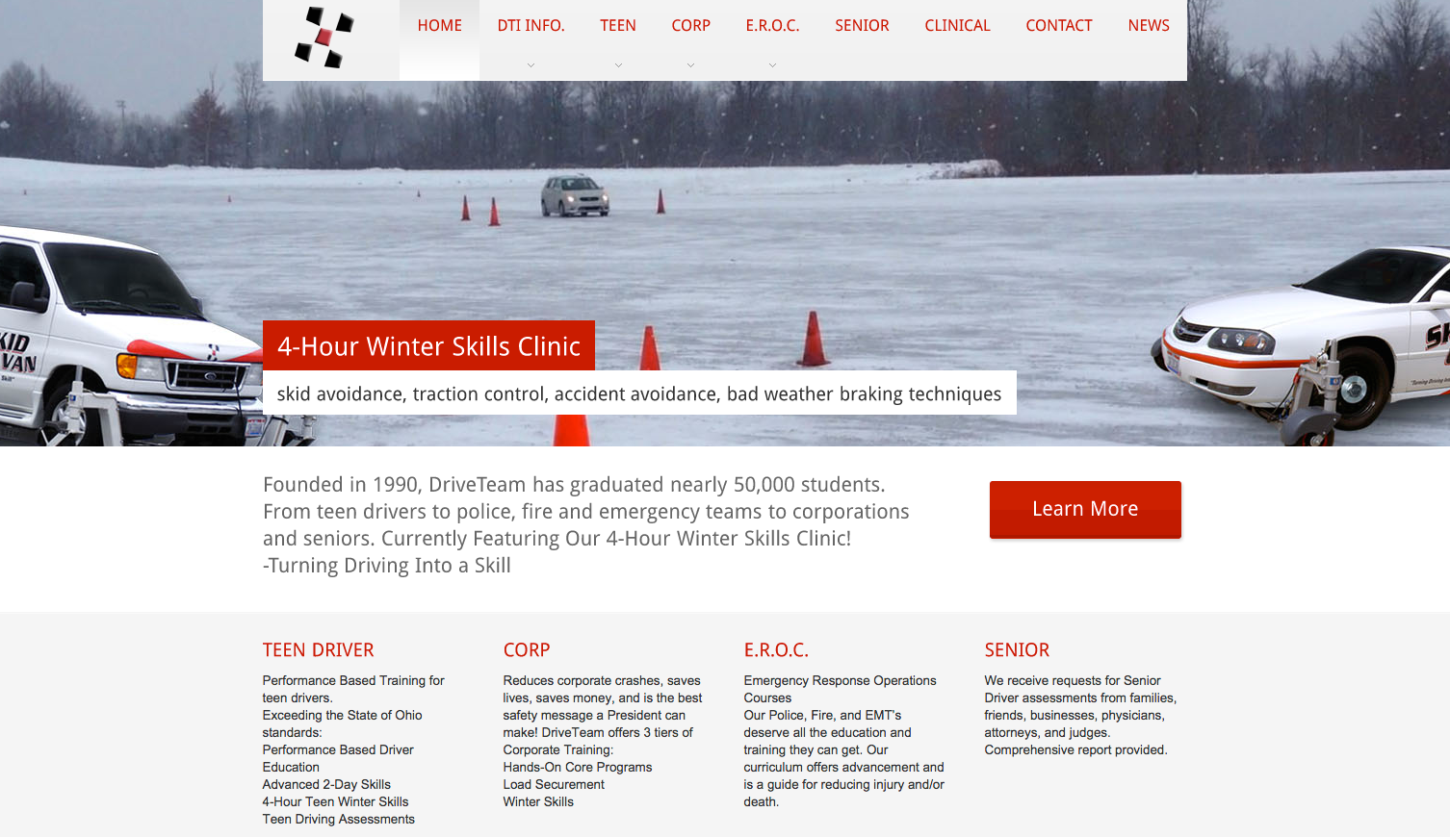



PRESENTED BY:
www.driveteam.com
info@driveteam.com
Phone: 330.922.3100

Slide 3

DriveTeam Training Divisions

Slide 4

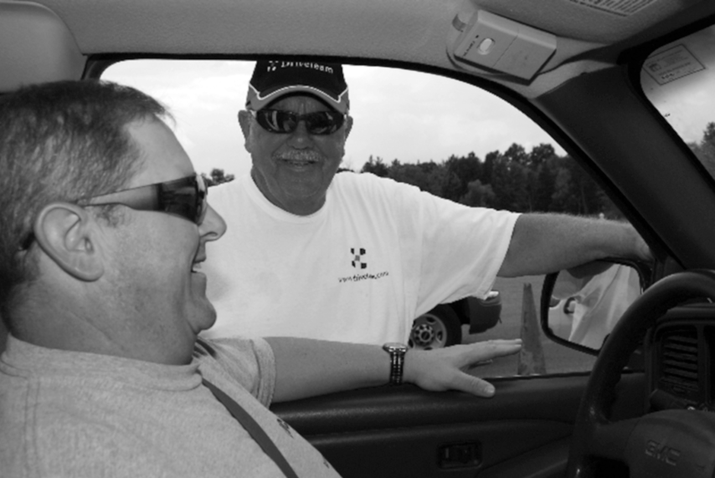
How Do We Become
Better Drivers?
Enhance Driver Knowledge
Increase Driving Skill
Professional Decision Making

Slide 5
VEHICLE SAFETY SYSTEMS
    Anti-Lock Braking System (ABS)
      Stomp, Stay, Steer
      Don’t Pump
      Look to Where You Want to Go
    Traction Control
      Helps Maintain Traction
      Limits Engine Output
      Applies Brake to Spinning Wheel
      Transfers Power to the Wheels with Traction
    Electronic Stability Control
      Braking on Individual Wheels
      Detects the Vehicle is out of Control
      Applies Brakes to Maintain Control
      Engine Power is Reduced

Slide 6
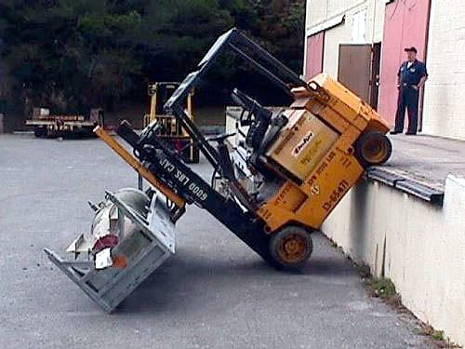
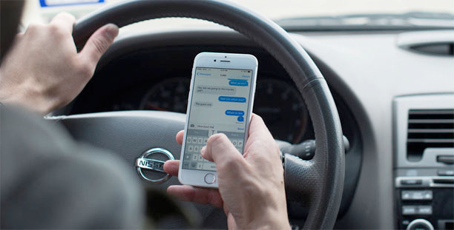
DISTRACTED?
Cell Phones
Eating
Computers/Pads
GPS
Other Passengers
Vehicle Monitoring
Apps

Slide 7

YOU CAN’T FULL THE BRAIN

Slide 8
KNOWLEDGE
+
SKILL
DECISION MAKING
=
PRODRIVER
=

Slide 9
THANK YOU!
www.driveteam.com
info@driveteam.com
Phone: 330.922.3100

